Slide 1
Getting Started with the MCU Extension
Follow these steps to get started:
Download the zip file for your platform (Mac or Windows) from Releases · WidnerM/GP-MCU (github.com)
From the zip file install the extension (.dylib for Mac, .dll for Windows) to the appropriate GigPerformer folder
/Users/Shared/Gig Performer/Extensions on Mac
C:/Users/Public/Documents/Gig Performer/Extensions on Windows
Load the Demo gigfile from the zip file in GigPerformer
Define the midi ports that your controller utilizes as described below in “Setting the MIDI Ports”
You may need to exit and restart GigPerformer after the first time you enable the extension
Setting the MIDI Ports
The extension will not know what midi ports your MCU-compatible device is on unless you tell it. You can tell the extension which MIDI ports to use by creating two text widgets in the global rackspace and setting them appropriately.
These widgets must be named “mcu_midiin” and “mcu_midiout” (using the Advanced tab in the “OSC/GPScript Name” field).
Set the Caption for these widgets (on the General tab) to the MIDI port names exactly as they appear in the GP MIDI ports list. The extension will read each of these as a comma separated list of midi port names.
Basic Operations and Troubleshooting
Before going too far with configuring a Rackspace you should make sure the extension is communicating with your controller. It is highly recommended to load the example Gigfile and verify that moving your knobs and faders moves the widgets and vice versa. The first Rackspace in the example Gigfile is there just to verify the widgets and controller are being linked.
Once that’s working, you should figure out which buttons on your MCU cycle the display between showing Widgets, Rackspaces, or Songs. There are “presets” to put these in convenient places on the Platform M+, the X-Touch, and a real MCU. You can select these under the “Extensions -> MCU Extension” menu item.
To sync your Rackspace with the MCU after adding new control widgets you should change Rackspaces, then come back. This is necessary because the extension only scans for new widget names upon Rackspace entry.

Slide 2
Overview of the GigPerformer MCU Extension
Many control surfaces utilize the Mackie Control Unit (MCU) protocol. This MCU extension is designed to communicate with such units. Popular currently made examples include the Behringer X-Touch, Icon Platform and Qcon, PreSonus FaderPorts, and SSL UF8.
Some MCU-compatible units offer displays similar to the original MCU, others do not. Either way, OSC can also be used to communicate substantial additional information about control mappings to a display device near your control surface.
Control Organization
The MCU extension works with control surface items in groups by type: knobs, buttons, and faders.
The extension is built around the concept of “banks” of each control group. You can have multiple knob banks, fader banks, etc.
The extension can “bank switch” through as many banks of such controls as you care to have in your Rackspaces.
The extension will automatically link Rackspace/Song and Variation/Songpart selection to a row of buttons on the MCU. You can tell the extension which rows you want these assigned to using the widgets named “mc_rackrow” and “mc_variationrow” in the Global rackspace. The options are “solo, mute, rec, sel, fn, or view”.
Controlling GigPerformer with the MCU Extension
Configuration of how GigPerformer interacts with the MCU is done through widgets.
On the “Advanced” tab of each GigPerformer widget there is a field called “OSC/GPScript Name”. Any widget with a name that begins with “mc_” will be examined by the extension for information about how it should be utilized by the extension.
Widgets utilized by this extension fall into three broad categories:
Control Widgets – knobs, button, etc. widgets typically linked to plugin parameters or system functions
Indicator Widgets – provide feedback in GP showing which banks of Control Widgets the MCU is actively controlling
Parameter Widgets – used primarily to determine how Control Widgets are displayed

Slide 3
Control Widgets
“Control Widgets” are typically knobs, faders, buttons, etc. linked in GP to plugin parameters. To be utilized by the MCU extension the GPScript Name must conform to the following format:
mc_type_bankID_position
“mc” identifies it as a widget of interest to the MCU extension
“type” indicates which row of MCU controls the widget will be associated with. The choices are:
k = knobs
f = faders
solo, mute, rec, sel, = button rows aligned with the faders/knobs
fn, view = additional button rows
“bankID” is any arbitrary name for this group of widgets that is meaningful to you. Typical examples:
“Pan” for panning controls of a mixer plugin
“solomute” if you wanted two RGB button rows to control solo/mute on a mixer plugin
“position” must be in the range of 0 – 8 to indicate which control position the widget is linked to
Faders are numbered 0-8 with 8 being the Master fader. All others are 0-7, arranged left to right
For example, a bank of eight knob widgets you want to use to control panning in a mixer could be named:
mc_k_pan_0 mc_k_pan_1 mc_k_pan_2 mc_k_pan_3 . . . mc_k_pan_7
The bankID “pan” in this example is entirely arbitrary. I generally use bankID’s that are descriptive, but you could just as easily name your banks things like “bank1” or “xyz” if you’re so inclined.
The purpose of this bankID is so that you can select among multiple banks. You can define as many banks as you want of each control type.
If you want to keep things simple you can just use a single bankID and not bother with bank switching.

Slide 4
Parameter Widgets
“Parameter Widgets” are optional and can be used to specify how Control Widgets appear on the MCU display.
Parameter Widgets must be named with the same format as the Control Widget they relate to, but by appending a ‘p’ after the ‘type’ field. e.g., mc_kp_pan_3 would be related to Control Widget mc_k_pan_3
If a Parameter Widget exists for a give Caption Widget, the extension will look at the caption of the Parameter Widget for two things:
the caption of the Parameter widget will be displayed on the LCD when the bank is currently active on the MCU and it is being displayed on the LCD
if an underscore character “_” appears in the caption, the extension will look for an integer after it, which will control the resolution of the knob. The default resolution is 200 clicks to cover the entire range of the knob. For finer resolution use a higher integer.
an example caption might be “GtrVol_300”, which would cause “GtrVol” to appear on the display and change the resolution of the knob to provide a finer level of control than the default
The primary use of these widgets is that you may want your Rackspace to display things differently than they appear on the MCU display (because of length or character set limitations).
I usually create Parameter Widgets as text widgets in GP and hide them so they are only visible in Edit mode.

Slide 5
Indicator Widgets
“Indicator Widgets” are similar to Parameter Widgets, but instead of controlling the display of widgets on the MCU they are used to show on the Rackspace screen which widget banks are actively being controlled by the MCU.
For example, if you have three separate banks of knobs in a Rackspace (e.g., instrument parameters, reverb parameters, and pans) it can be helpful to see on the GigPerformer screen which ones are actively linked to the knobs on the MCU as you change active banks.
Indicator Widgets are named with the same format as Control and Parameter widgets but with “_i” in place of the _position.
e.g., mc_k_pan_i
Indicator Widgets are generally created as Text widget, most often with the text itself being blank or with the Text Color alpha set to zero so that the text itself does not appear on the Rackspace screen.
When the bank specified is “active” the extension will set the value of the widget to 1, which will raise its visibility on the Rackspace screen. When the bank is not active the value will be set to 0.3, which will reduce its visibility. A common use of these widgets is as an outline and background behind the associated set of Control Widgets.
Note – GigPerformer will remember Indicator Widget values when switching between Rackspaces/Variations/etc. As a result it will remember which banks you were controlling when you last used or saved a Variation, and when you return to it those same banks will be “active” again on the MCU.

Slide 6
LCD Display
The MCU LCD displays are organized as two lines of text with seven characters each, aligned with each row of faders/knobs. On some units the displays of adjacent tracks run together; on others there is a gap. This can have a significant impact on readability.
At any given time the extension will display captions of either the active Fader bank, Knob bank, or Songs/Rackspaces.
Standard button assignments are:
EQ, Pan, Track – select Faders, Knobs, or Songs/Rackspaces to be displayed on the LCD display
<< >> - cycle through Fader banks
< > - cycle through Knob banks
Transport << and >> - cycle through Songs/Rackspaces in groups of 8
Record – toggles in and out of Setlist mode
Stop – stops the playhead
Play – starts the playhead
Jogwheel – adjusts tempo
Other button layouts can be selected from the MCU Extension menu in GP. The purpose of the different layouts is to (try to) put the control buttons in positions that will be logical or easy to remember.

Slide 7
BankID Linking
If the same bankID is used for different control rows (e.g., Faders and Knobs) then when that bankID is selected to be active for one control row (e.g., Knobs or Faders) it will be selected for all rows that have a bankID of that name.
For example, if you want to be able to bank select between three separate 8 channel mixers plugins and have the entire control surface move together between them you would use Widget names like:
mc_f_mix1_0 … mc_f_mix1_7 and mc_k_mix1_0 … mc_k_mix1_7 and mc_mute_mix1_0 etc.
mc_f_mix2_0 … mc_f_mix2_7 and mc_k_mix2_0 … mc_k_mix2_7 and mc_mute_mix2_0 etc.
mc_f_mix3_0 … mc_f_mix3_7 and mc_k_mix3_0 … mc_k_mix3_7 and mc_mute_mix3_0 etc.
Named as such, when you bank select (using the << or >> Fader bank select keys) you will automatically also select the corresponding set of Knobs, Mute buttons, and any other button rows where you used that bankID.
In contrast, if you want to use the same three mixer plugins but be able to independently control the Volumes from the first on the MCU faders, the pans from the second on the MCU knobs, and the mutes for the third on the MCU mute buttons, you must use different bankIDs for each widget row. A simple example would be:
mc_f_volume1_0 … mc_f_volume1_7 and mc_k_pan1_0 … mc_k_pan1_7 and mc_mute_mute1_0 etc.
mc_f_volume2_0 … mc_f_volume2_7 and mc_k_pan2_0 … mc_k_pan2_7 and mc_mute_mute2_0 etc.
mc_f_volume3_0 … mc_f_volume3_7 and mc_k_pan3_0 … mc_k_pan3_7 and mc_mute_mute3_0 etc.
NOTE: there are presently no independent MCU key assignments for cycling through button banks. This is because there are too many independent button rows to make this practical and no obvious keys in the layout for doing so.
In my Rackspaces I tend to have either A) only one bank for each button row, or B) button rows that utilize multiple banks having bankIDs exclusively aligned to Knob or Fader bank bankIDs.
It may be easy enough to get around this by holding down something like the “Shift” key and simultaneously pressing the first or last button of an individual button row to bank switch that row. However, because of the limited visual feedback, the plethora of buttons available on the MCU, uncertainty that different hardware will respond similarly to held buttons, and inability to reliably do the same through an OSC display I have not found this worth pursuing.

Slide 8
Song and Rackspace Selection Buttons
Song/Rackspace and Songpart/Variation selection can be automatically linked to different button rows using widgets named “mc_rackrow” and “mc_variationrow”. The caption of each widget will specify what button row you want them assigned to. The options are the same as the “_type_” fields of the widget names. i.e., solo, mute, rec, sel, fn, view.
When these options are utilized the Songs/Racks or Songparts/Variations can be changed by pressing the appropriate button on the row. The first Song/Rack is assigned to the leftmost button on the row and successive ones are assigned going left to right.
The << and >> buttons in the transport area will shift the buttons to the next 8 Racks/Songs. The currently active Rack/Song or Variation/Songpart will have its button lit on the surface.
If these widgets are utilized they will override any other widgets assigned to those button rows.
When displaying Songs or Rackspaces the configuration of the display changes such that
MIDI Device Selection
The MCU extension will look for widgets named “mc_midiin” and “mc_midiout” to determine which devices to attach to. The captions in these widgets contain a comma separated list of MIDI device names that the extension will attempt to connect to. These names must match the names that show up in the GigPerformer “Options -> MIDI Port” configuration window.
I typically list my physical MCU units as well as OSC virtual MIDI ports so that I can use an OSC either instead of, or in conjunction with, a hardware control surface. The extension receives MIDI information on the “mc_midiin” ports and outputs to the “mc_midiout” ports. The “vMCUin” and “vMCUout” ports are configured for OSC communication by default.
The MCU protocol is designed to accommodate 32 separate “channel strips” plus the master channel. In practice this means three “extension units” can be attached to a “master” MCU unit to give 32+1 faders, knobs, etc. This extension will only communicate using the data protocol associated with the first 8 channels plus the master fader. Most MCU compatible controllers default to this setting.

Slide 9
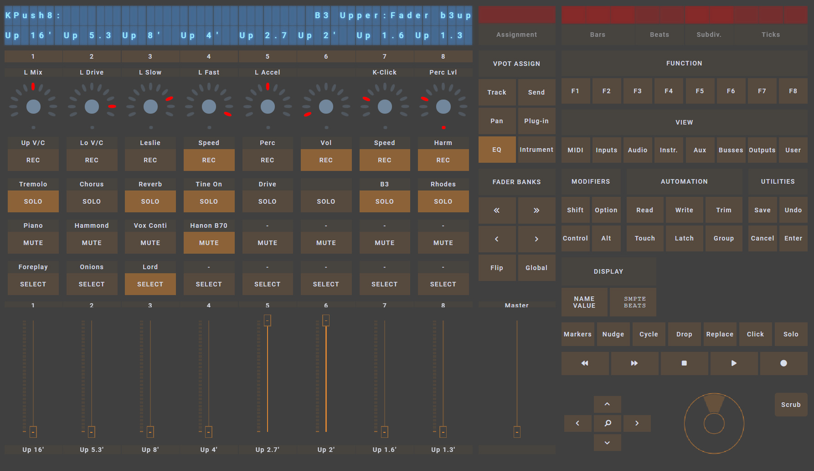
Using with Open Stage Control (or OSC in general)
There are so many buttons on MCU units that I am prone to forgetting what I have assigned where. To address this I often use Open Stage Control to show what is assigned where. I sometimes put this on a touch screen and don’t even use a physical MCU unit.
A (modified) version of an MCU template by the creator of Open Stage Control is shown below.
A Touch OSC template is here: https://github.com/NicoG60/TouchMCU (which I have not tested)

Slide 10
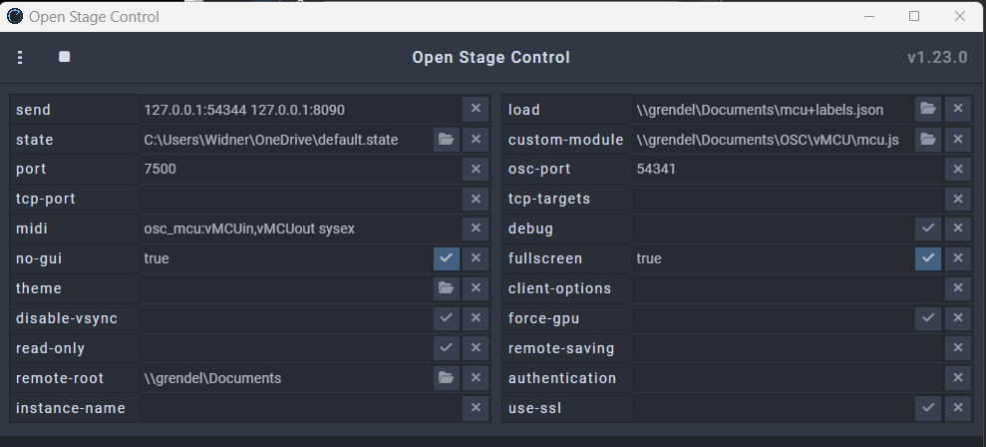
Setting up Open Stage Control for Use with This Extension
Detailed instructions for setting up and using Open Stage Control in general is outside the scope of this document. I will just go over some basics here for getting it to work in conjunction with this extension.
First, you need to download a recent version of Open Stage Control from Open Stage Control (ammd.net)
Unpack the zip file into a location of your choice. It does not require installation beyond that.
Execute the open-stage-control.exe (on Windows) executable and configure the options screen as shown below:
The key lines are Send, Port, midi, and osc-port.
Choose what ports you like, but they must match
what you set in GigPerformer. In this example
I’m using 54344 on the send line and 54341 on
the osc-port line.
These should match the Listening Port and the
Remote Client Port respectively in GP.
The Custom-Module line refers to the MCU
Emulator for Open Stage Control. This can be
downloaded from the link below, and the
Custom-Module line should point to the mcu.js
File in the location where you un-zipped the folder.
The download link for the MCU emulator for Open Stage Control is: jean-emmanuel/open-stage-control-mcu (github.com)
The Load line in the OSC configuration should point to the template you want to load. The repository for this extension includes a template set up to match the Icon Platform M+ and a modified version of the Mackie MCU template from the above download link.
The Midi line in the image above reads “osc_mcu:vMCUin,vMCUout sysex”. The “osc_mcu” part is the identifier used in the OSC templates for the midi stream. The “vMCUin,vMCUout” part are port names as recognized by your OS. On Windows I use loopMIDI to create these. The “sysex” part tells Open Stage Control to allow sysex over this connection.

Slide 11
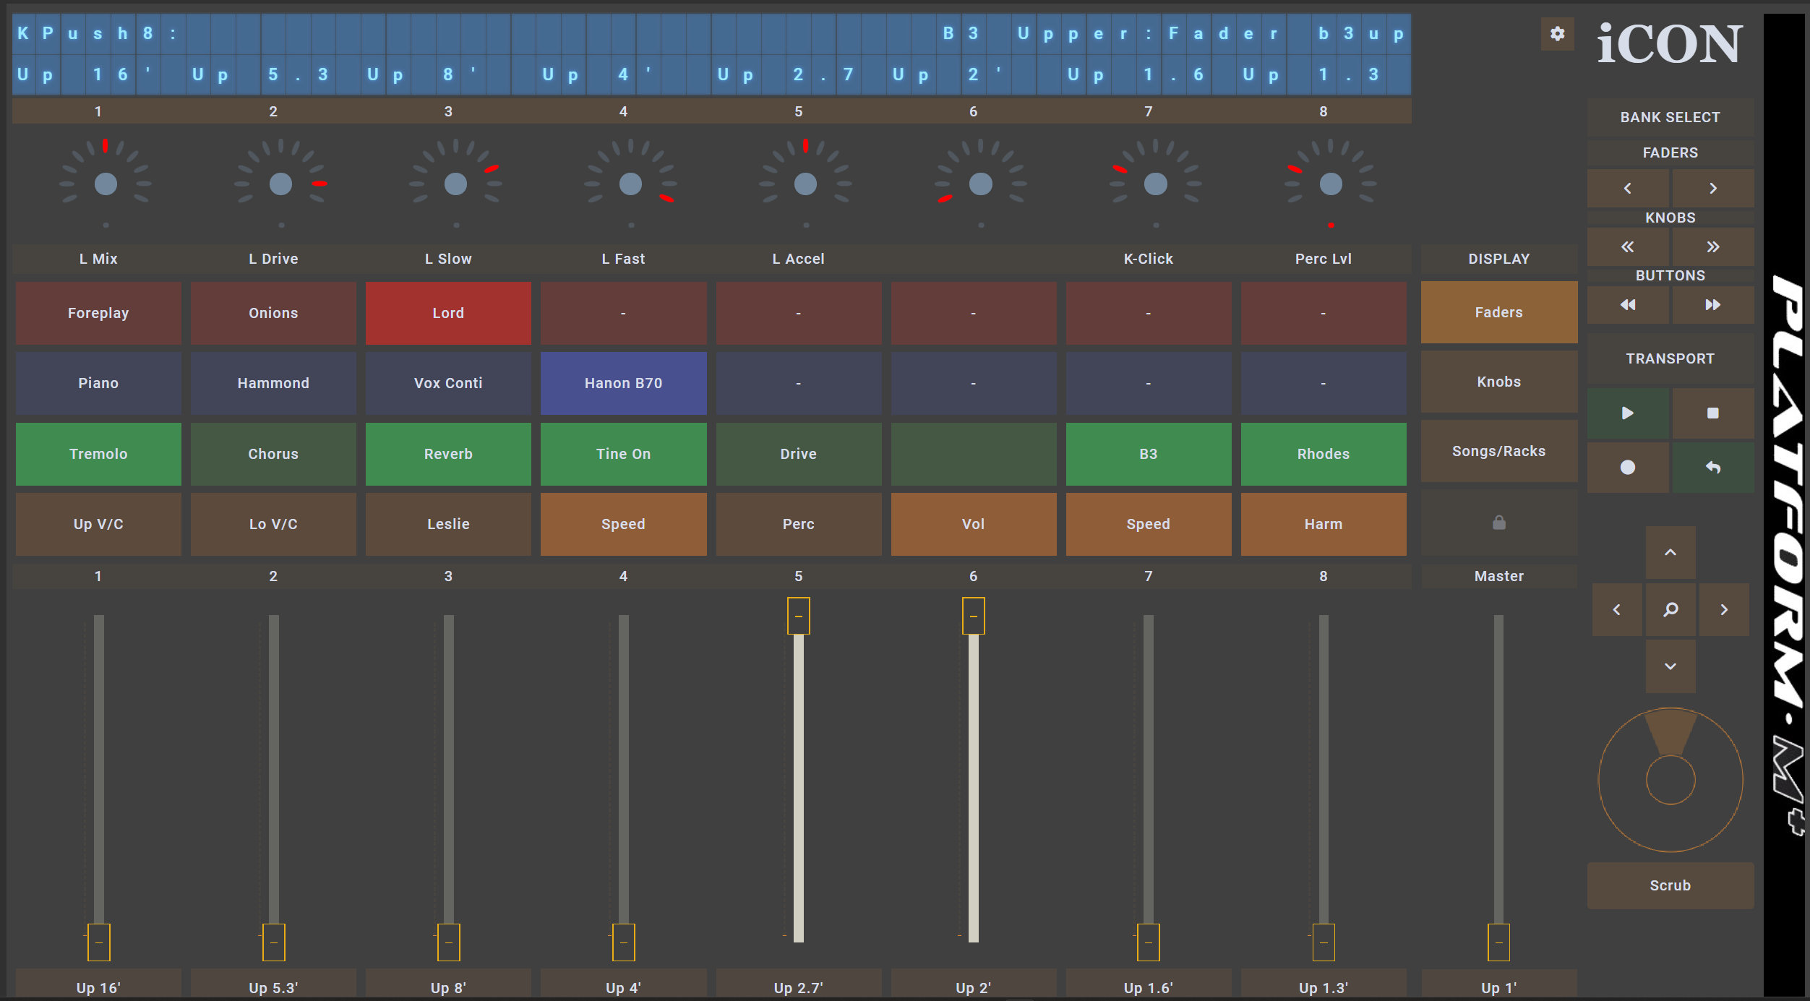
I modified the template to match the layout of the Icon Platform M+, to add text labels to the buttons, knobs, and faders, and to map the View and Function buttons to the top of the display.
In this Platform M+ template the button rows are colored and ordered to correspond to the colors on a real Platform M+. The order these rows appear in (rec, solo, mute, select) appear to vary across different MCU-emulating controllers.
Sometimes I attach a touch display to my Platform M+ (instead of using the LCD display) to make it easier to see what’s attached to what. The Viewsonic TD1655 and probably any other display in the 15” diagonal range aligns the controls pretty well.

Slide 12
Known Issues and Other Comments
The extension does not utilize the Bar/Beats/Ticks portion of the MCU display.
The MCU protocol calls for an initial “verification” exchange between the DAW and the MCU to allow it to function. It also calls for periodic “keep alive” messages to keep the connection working. This appears to have been part of a closely guarded “protection” scheme intended to only let licensed software communicate with official hardware. Current hardware does not generally use this, and this extension does not either as I have no mechanism to test it.
Many hardware devices claim to be “MCU compatible” or “HUI compatible” but it appears that definition varies widely.

